Slide 1


Lesson 5 We are a good team!
UNIT 1

Slide 2
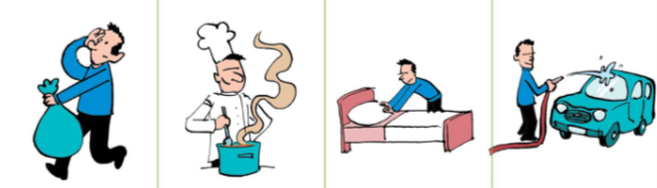
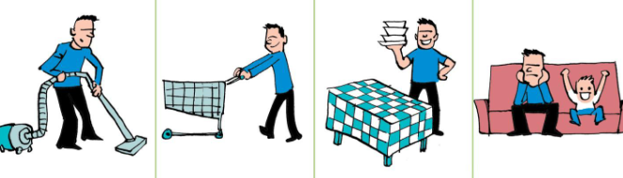
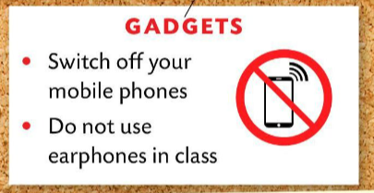
Revise household chores and rules with these 2 games.
https://wordwall.net/play/5140/383/361
https://wordwall.net/play/510/637/881

Slide 3
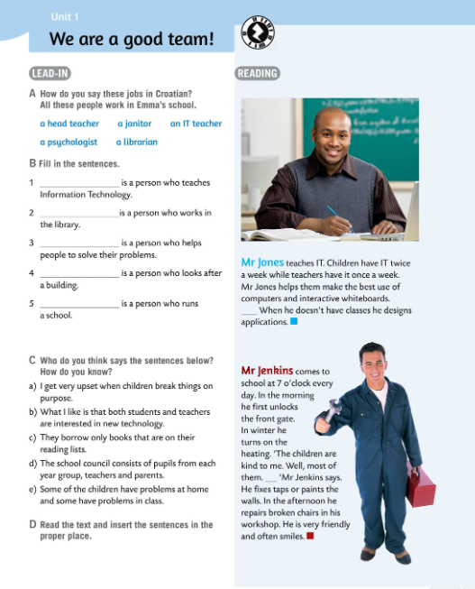
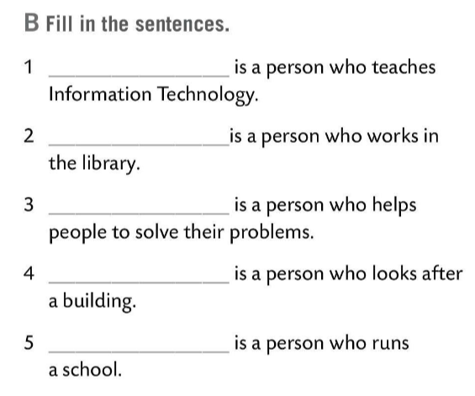
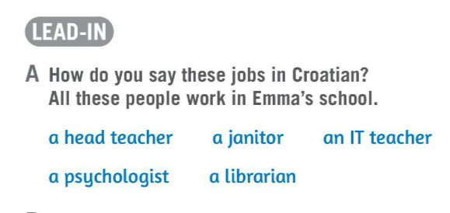
Translate:
a head teacher – ravnatelj
a janitor – domar
an IT teacher – nastavnik/ca informatike
a psychologist – psiholog/inja
a librarian – knjižničar/ka
An IT teacher
A librarian
A psychologist
A janitor
A head teacher
Fill in the sentences in Task B with the words from Task A.
Check.

Slide 4
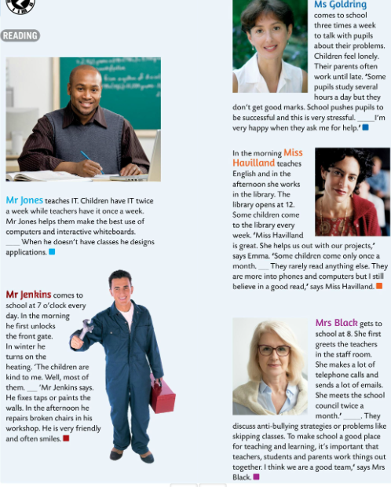
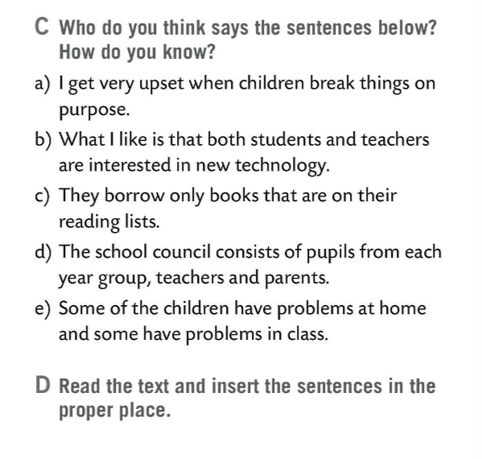
Read the sentences in Task C.
Who says them?
Check.
e
a janitor
an IT teacher
Read the text and put the sentences from Task C into the correct paragraph.
Check.
b
a librarian
c
a head teacher
a psychologist
a
d

Slide 5
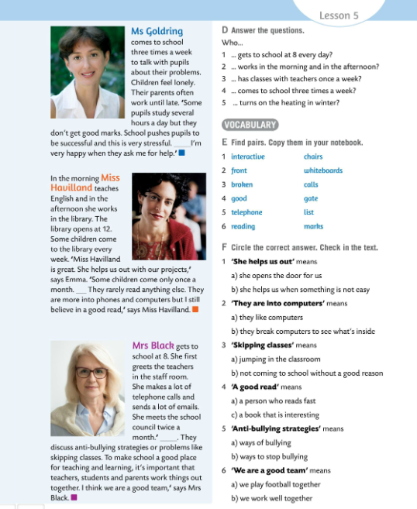
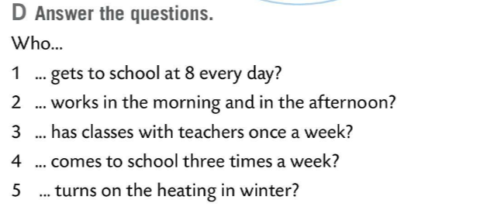
Answer the questions in Task D.
Check.
1 Mrs Black gets to school at 8 every day.
2 Miss Havilland works in the morning and in the afternoon.
3 Mr Jones has classes with teachers once a week.
4 Mrs Goldring comes to school three times a week.
5 Mr Jenkins turns on the heating in winter.

Slide 6
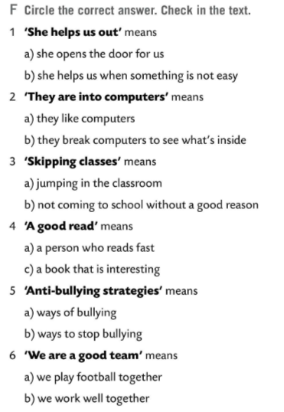

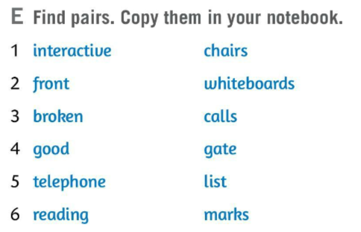
Find pairs in Task E.
Translate the words.
Copy the pairs in your notebook.
Check.
interactive whiteboard – pametna ploča
front gate – glavni ulaz
broken chairs – slomljene stolice
telephone calls – telefonski pozivi
reading list – popis djela za lektiru
Circle the correct answer in Task F. Then read the text once again and check.
Check.

Slide 7
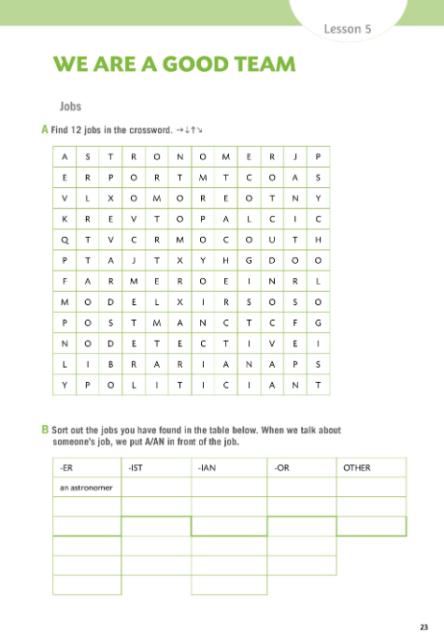

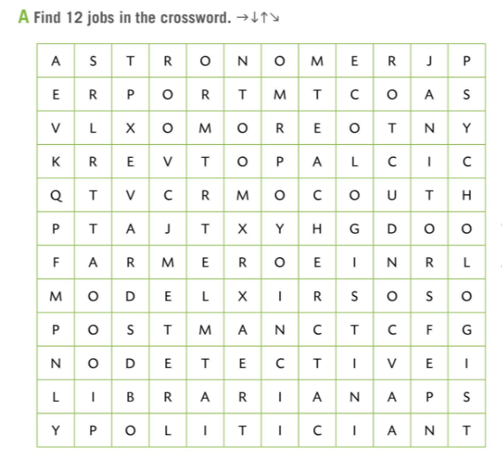
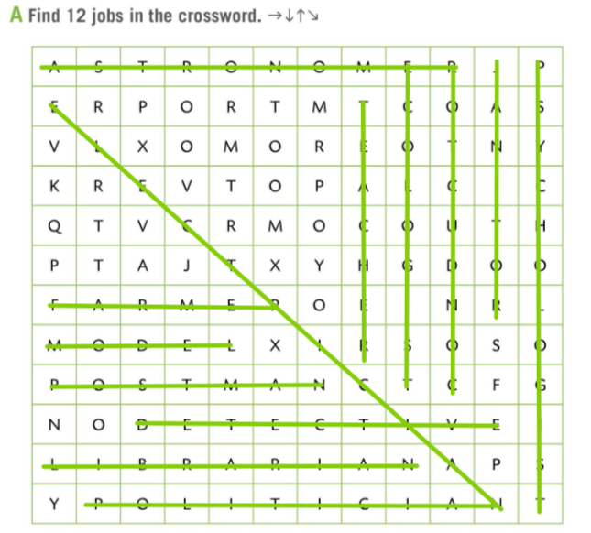
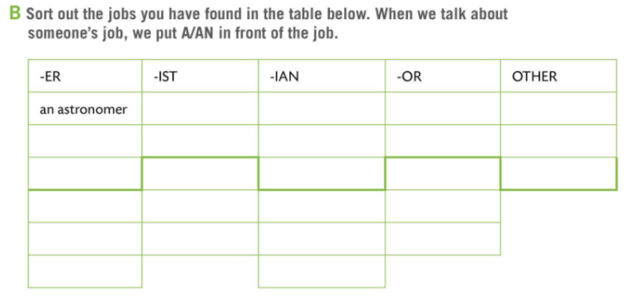
Workbook page 23.
Find 12 jobs in Task A.
Check.
Finish the table in Task B and sort out the jobs in Task A.
Remember! → We put A or AN in front of the job/profession.
Ispred naziva zanimanja dodajemo član A ili AN.
Check.
an ecologist
a librarian
a conductor
a model
a farmer
a psycologist
a politician
a janitor
a postman
a teacher
an elecrtician
a detective

Slide 8
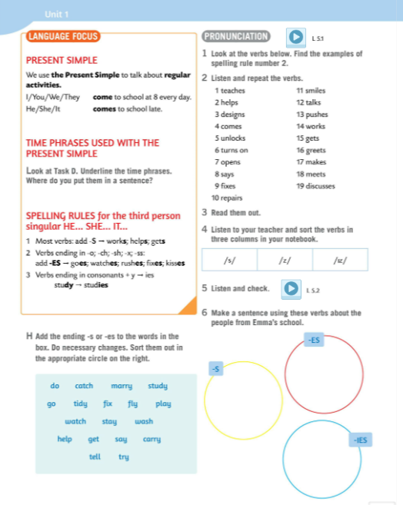
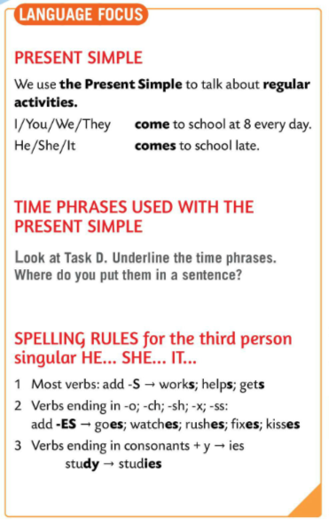
LANGUAGE FOCUS
We use Present Simple to talk about regular activities.
Present Simple, glagolsko vrijeme za izricanje sadašnjosti, koristimo za izricanje radnji koje se događaju svakodnevno, tj. redovito.
I / You / We / They come to school at 8 every day.
He/She/ It comes to school late.
We add –s or –es in the 3rd person singular. Dodajemo nastavak –s ili –es u trećem licu jednine (he, she , it).

Slide 9
Task D
Underline the time phrases.
Where do you put them in a sentence?
Check.
You put time phrases at the end of the sentence, after the verb.
LANGUAGE FOCUS
Spelling rules for the third person singular.
You add –S to the most verbs (works, knows..)
Većini glagola u trećem licu jednine dodat ćemo nastavak -S

Slide 10
You add –ES to the verbs ending in -o, -ch, -sh, -x, -ss.
(goes, watches, rushes, fixes, kisses)
Glagolima koji završavaju na -o, -ch, -sh, -x, -ss dodat ćemo nastavak –ES
Verbs that end in consonants + y → y change into i. (study → studies)
Glagoli koji završavaju na suglasnik ispred y, slovo y se pretvara u i + nastavak -es

Slide 11
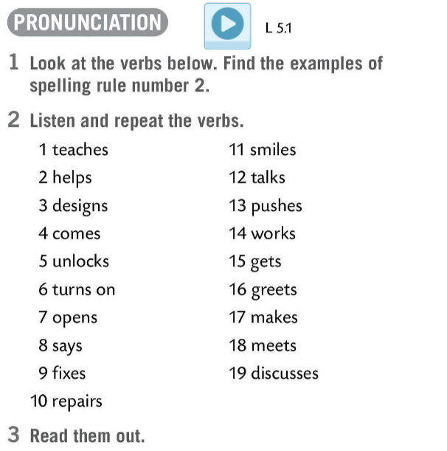
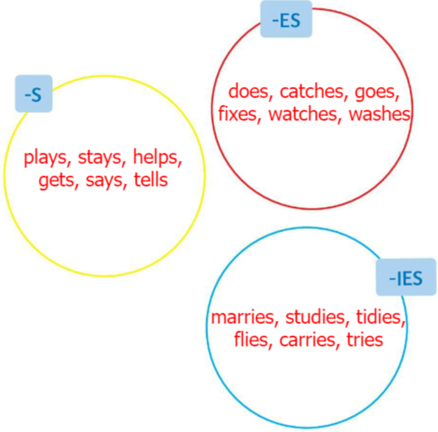
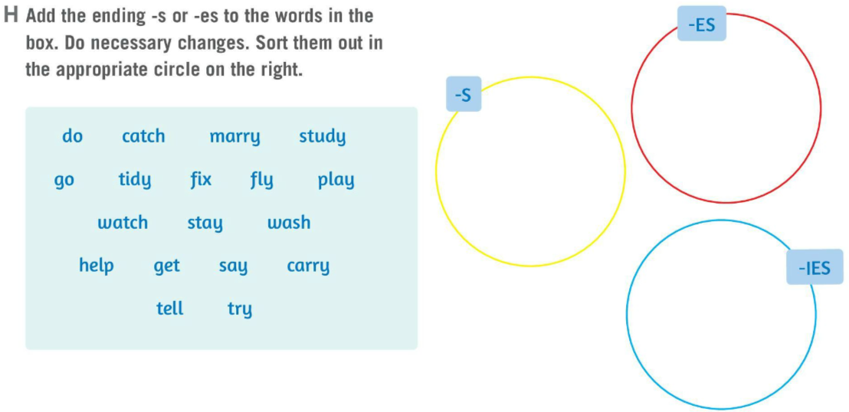

Do Task H. Add the ending –s or –es to the words in the box. Do necessary changes. Sort them out in the appropriate circle on the right.
Check.
PRONUNCIATION
Find the examples of spelling rule number 2.
Listen and repeat the verbs from Task 2.
Read the verbs from Task 2 aloud.

Slide 12
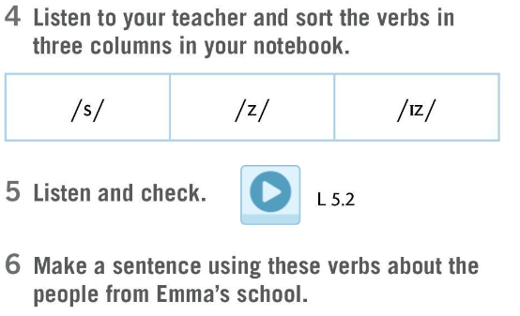
Draw a table like in Task 4.
Listen to your teacher and sort the words in the correct column.
Listen and check.
Make sentences using the verbs from Task 2 about the people from Emma’s school.

Slide 13
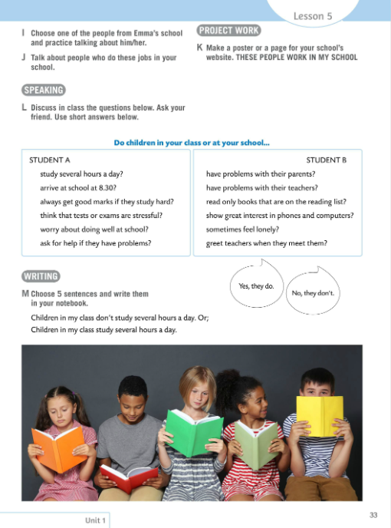
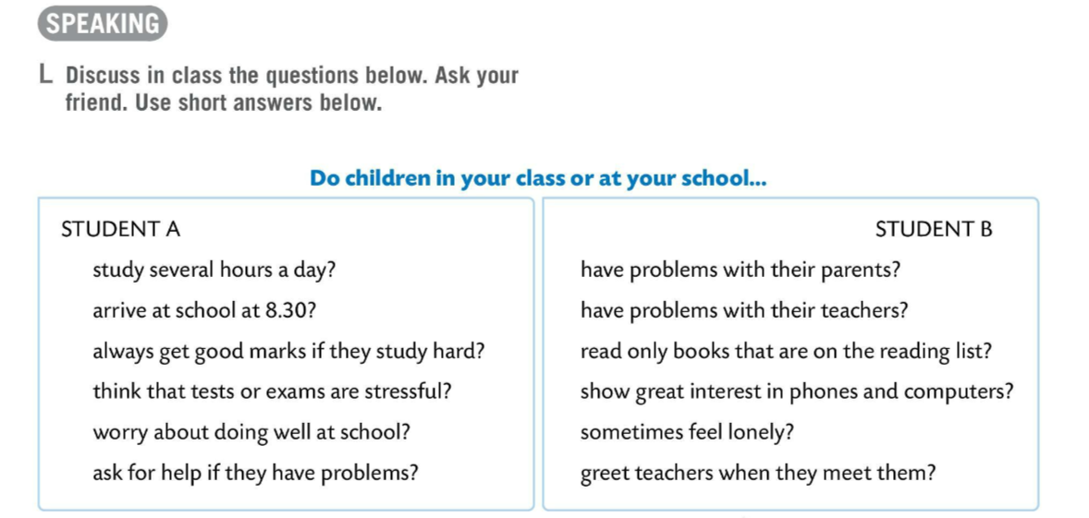
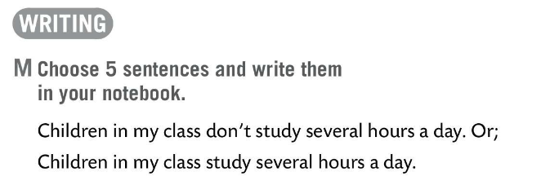
Choose one of the people from Emma’s school and practice talking about him/her.
Talk about people who do these jobs in your school.
Task L.
Discuss the questions. Ask your friend and use: Yes, they do. No, they don’t.
Choose 5 sentences and write them in your notebook.

Slide 14
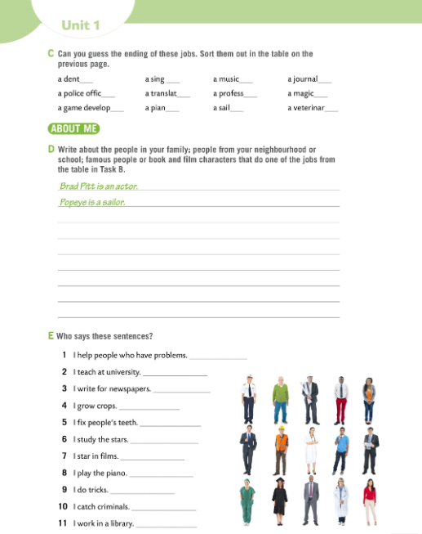
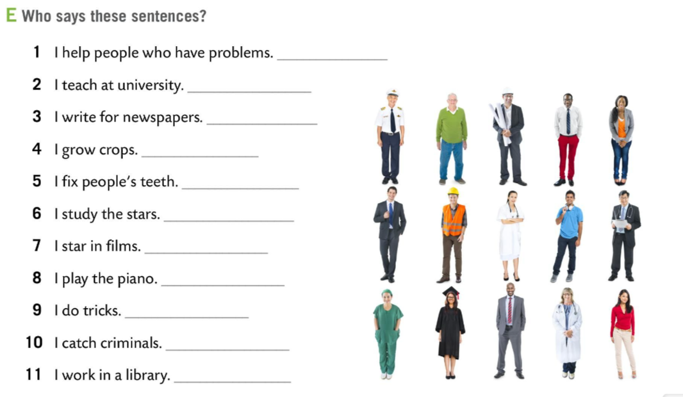
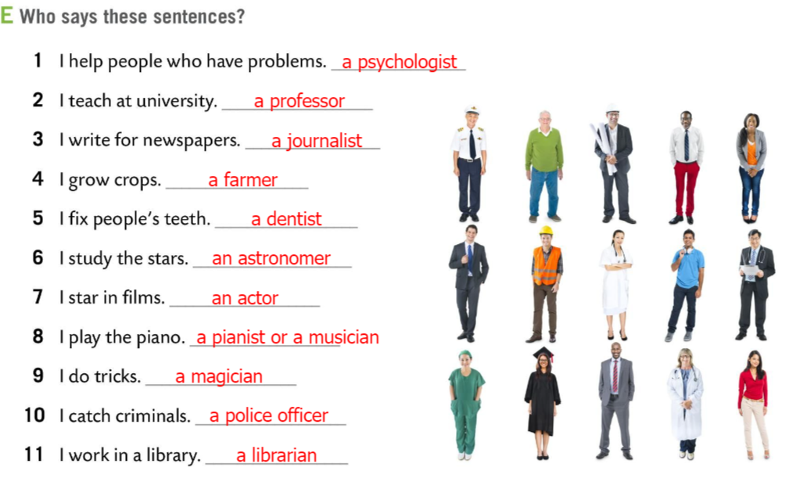
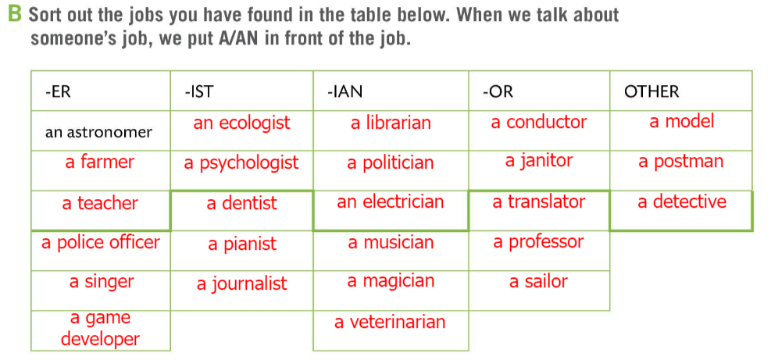
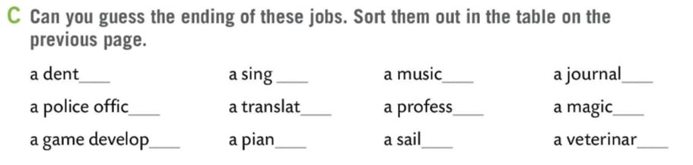
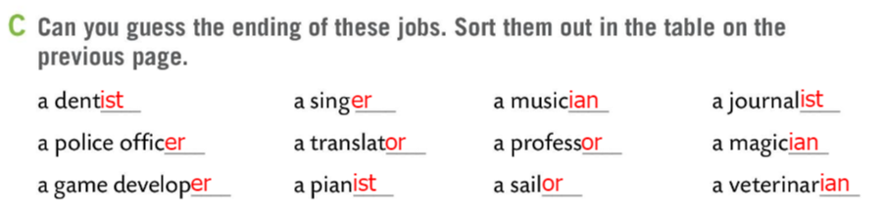
Workbook page 24.
Can you guess the ending of these jobs? Sort them out in the table on the previous page.
Check.
Who says the sentences in Task E.
Check.

Slide 15
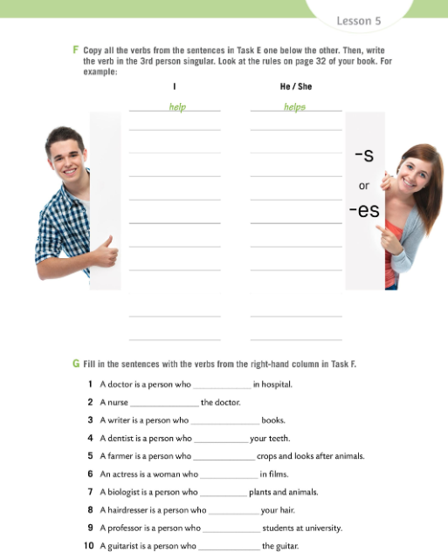
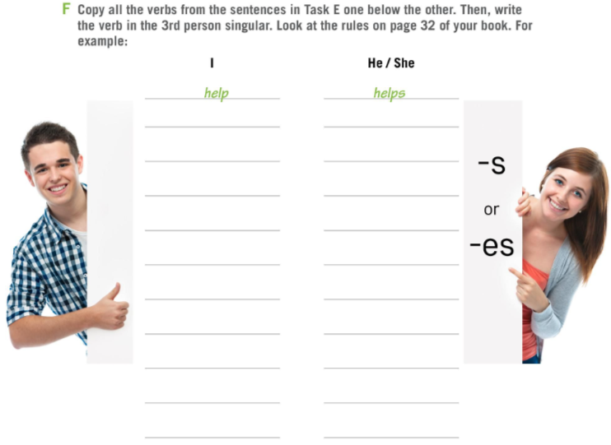
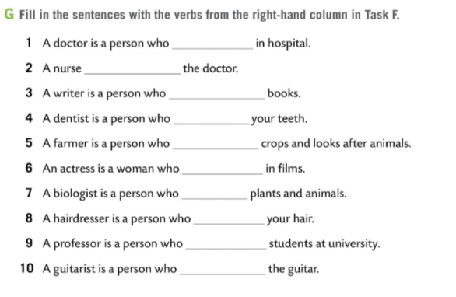
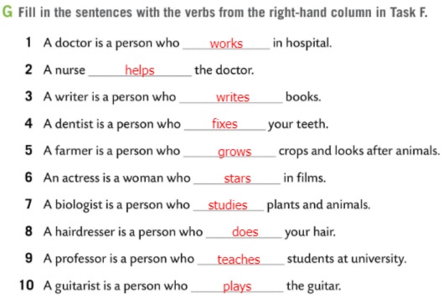
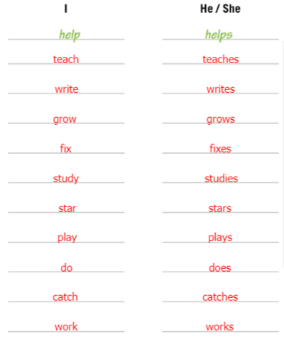
Workbook page 25.
Copy all the verbs from the sentences in Task E.
Write the verb in the 3rd person singular.
Look at the rules on page 32 of your book.
Check.
Fill in the senteneces in Task G with the verbs from the right column.
Check.

Slide 16
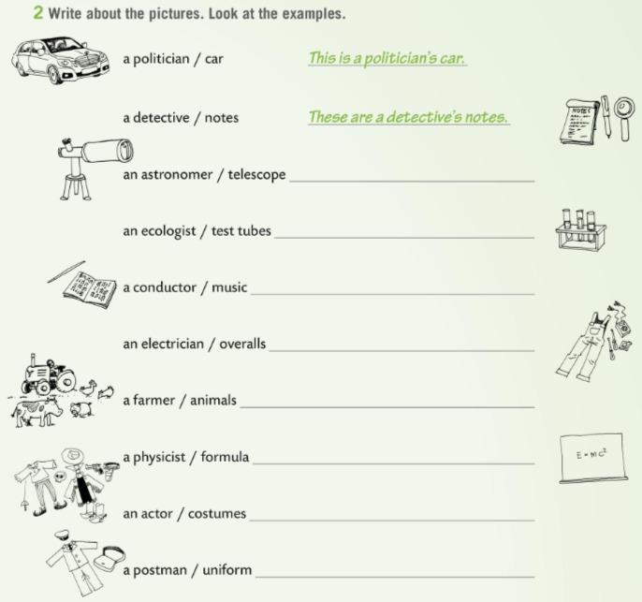
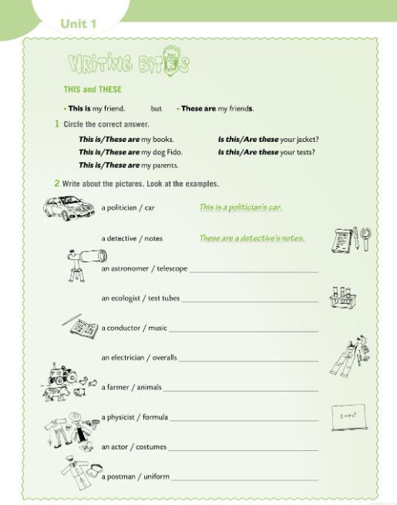
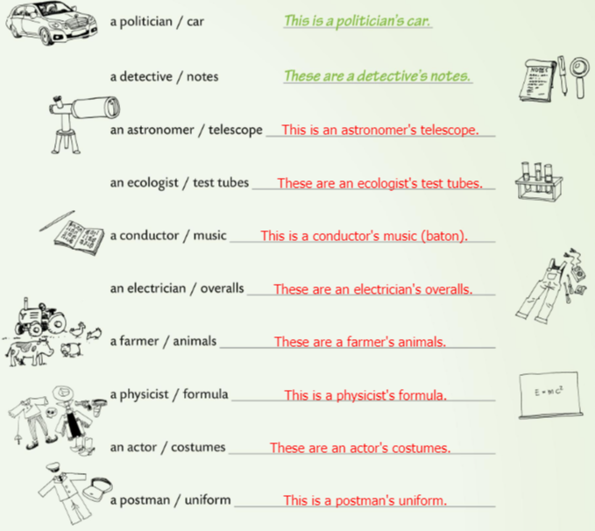
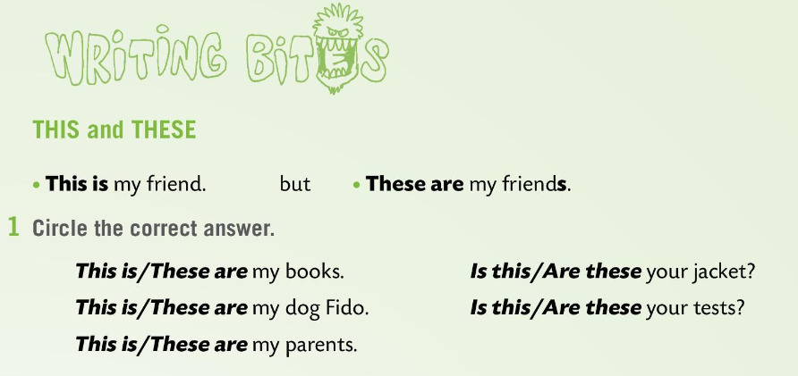
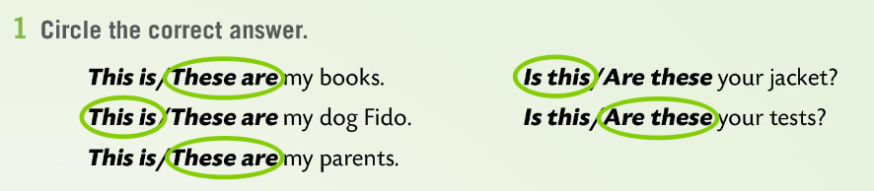
Workbook page 26.
WRITING BITES
We use THIS IS for singular and THESE ARE for plural.
THIS IS koristimo kada je imenica u jednini, a THESE ARE za imenice u množini.
Circle the correct answer in Task 1.
Check.
Write about the pictures. Look at the example in Task 2.
Check.

